Slide 1



1
House Dataset Analysis
Python Reinforcement project
SARANYA R
DA&DS - May Batch
21-July-2025

Slide 2

2
INTRODUCTION
The housing dataset provides comprehensive information on various attributes associated with residential properties, including price, square footage, location details, and other relevant features.
The objective of this project is to conduct an in-depth analysis of the dataset to derive valuable insights for stakeholders in the real estate industry.

Slide 3

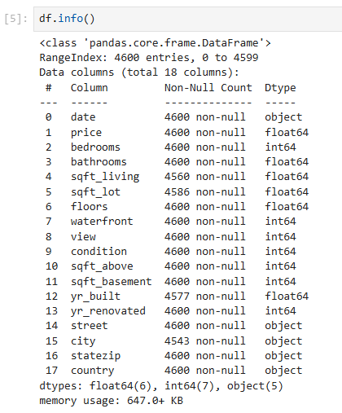
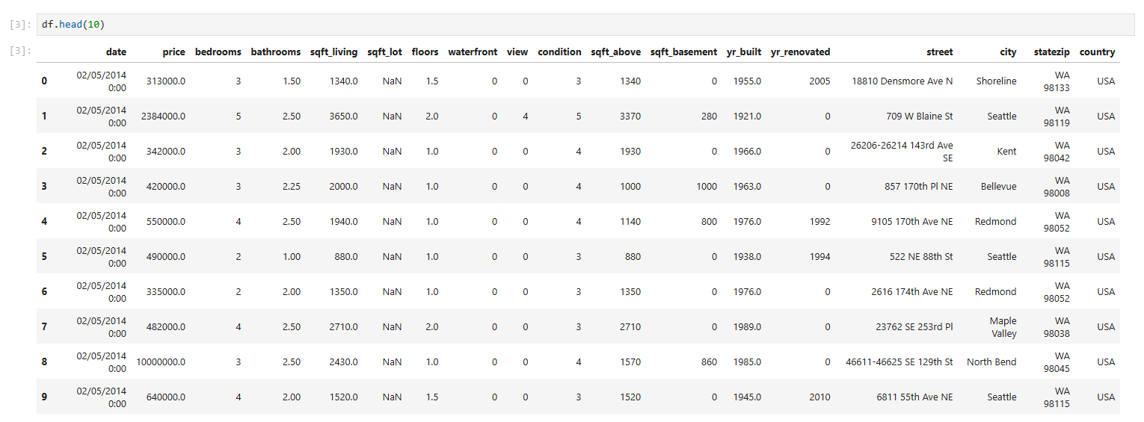
3
Data Understanding
The house dataset Contains real estate property listings with features like price, bedrooms, sqft, location, etc.
The house dataset Contains real estate property listings with features like price, bedrooms, sqft, location, etc.

Slide 4


4
Outlier Handling
Outlier data is a datapoint that differ from the rest of datapoint.
Box plots are a great way to visualize and identify outliers in a dataset.
Interquartile Range
(IQR)
MIN
MAX
Outlier data
Outlier data
Q1
Median
Q3

Slide 5

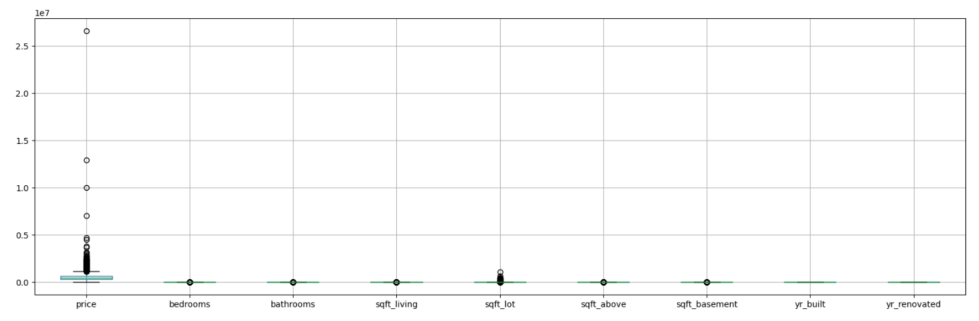
5
Outlier Detection
Before replacing outliers

Slide 6

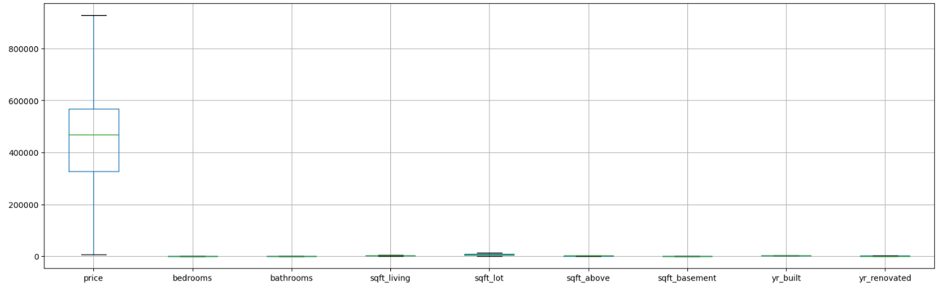
6
Replacing Outliers

Slide 7
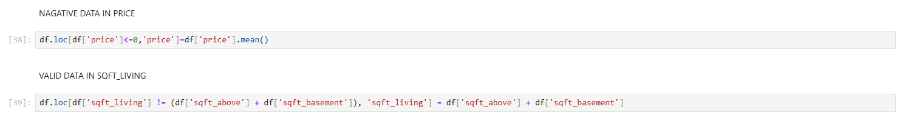
7
Handling Invalid Values
Negative Prices Corrected
Replaced illogical negative price values with the dataset's mean price to ensure valid analysis.
Sqft_living Validation
Ensured living area (sqft_living) matches the sum of above-ground and basement areas (sqft_above + sqft_basement) for consistency.

Slide 8

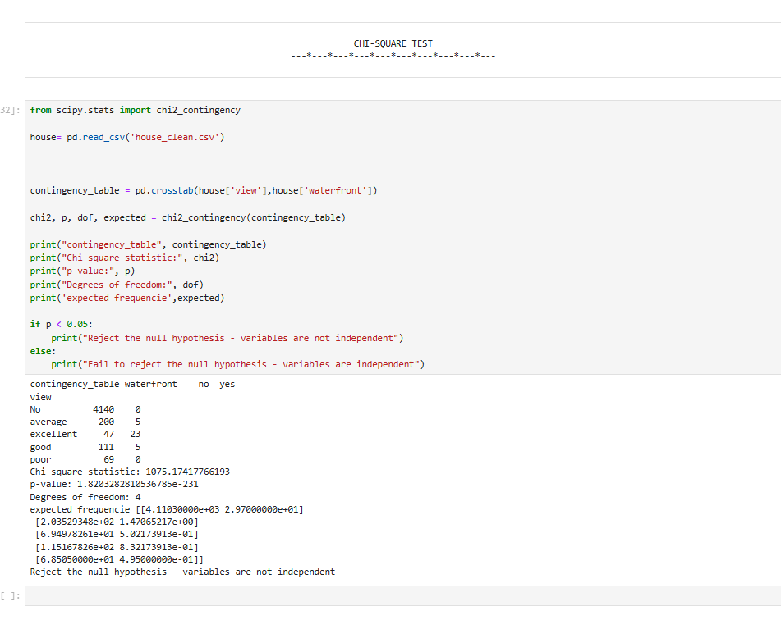
8
Statistical Analysis
Conducted hypothesis testing including t-tests, ANOVA, and chi-square to analyze price variations across property features.
Found significant price differences based on waterfront status (p=0.003) and property condition (p<0.001).

Slide 9

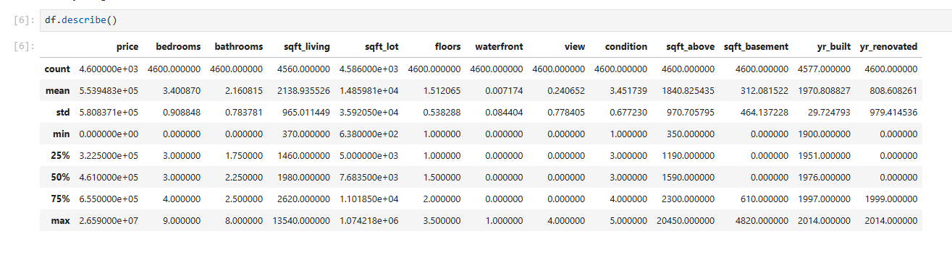
9
Descriptive Analysis

Slide 10

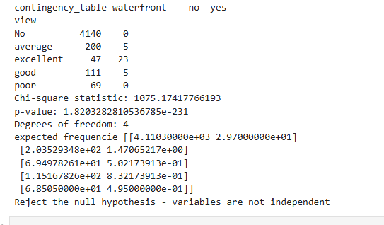
10
Relationships Between Variables
Analyzed relationships between price, waterfront status, and property condition using t-tests, ANOVA, and chi-square tests.
Key finding: Waterfront properties (p=0.003) and higher-condition homes (p<0.001) showed significantly higher prices.

Slide 11
11
Comparative Analysis
Data visualization is crucial because it transforms raw data into a visual format, making it easier to understand, analyze, and extract meaningful insights.
It helps identify patterns, trends, and outliers, facilitates faster decision-making, and enhances communication of information.
Types of visualizations used,
Bar Chart
Pie Chart
Scatter Plot
Hexbin Plot
Heatmap

Slide 12
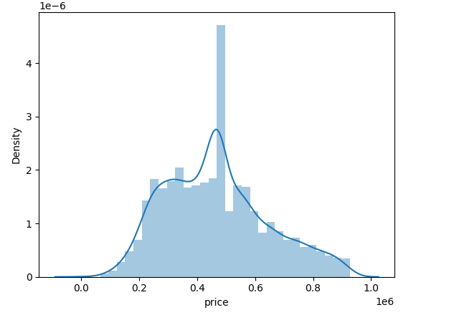
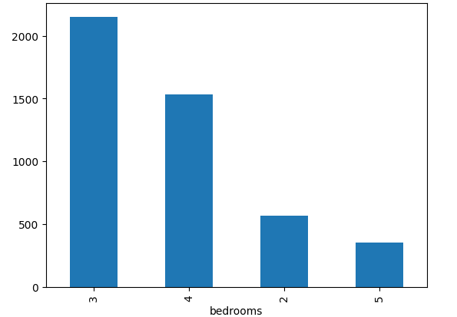
12
Univariate analysis
Univariate analysis in Python involves examining and summarizing a single variable at a time within a dataset.
Price distribution shows most homes are moderately priced with a few high-value outliers.
Living area follows a near-normal pattern with most homes between 1,000-3,000 sqft.

Slide 13
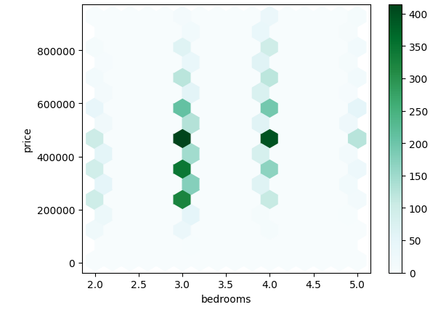
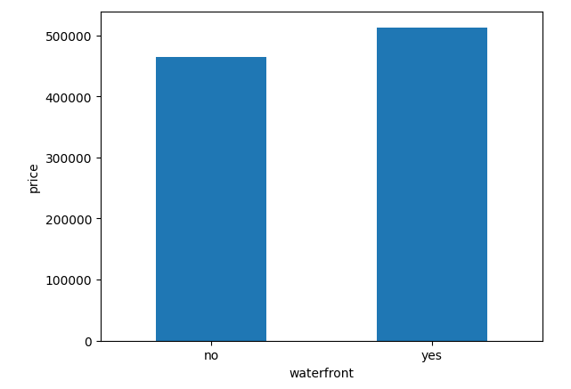
13
Bivariate analysis
Bivariate analysis in Python involves examining and summarizing a two variable at a time within a dataset.
Price distribution shows most homes are moderately priced with a few high-value outliers. Living area follows a near-normal pattern with most homes between 1,000-3,000 sqft.

Slide 14
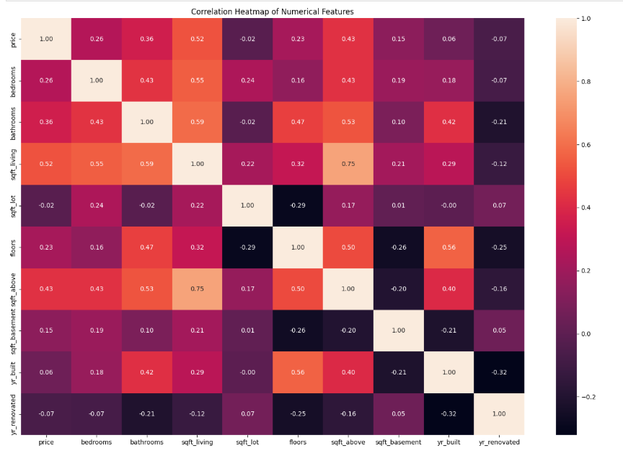
14
Multivariate analysis
Multivariate analysis (MVA) is a set of statistical methods used to analyze data when multiple variables
Strong Correlations: sqft_living shows high positive correlations with price (0.52), bedrooms (0.55), and bathrooms (0.59), indicating its importance in pricing.
Weak/Negative Links: yr_renovated has minimal or negative correlations with most variables (e.g., −0.21 with bathrooms), suggesting limited impact on other features.

Slide 15
15
Insights and Recommendations
Insights :-
Larger homes (higher sqft, more bedrooms) command higher prices.
Prices differ based on city. May be high population in those regions.
Renovated homes are ~9.7% more expensive on average than unrenovated homes. This shows that renovations generally add value, but the premium is moderate.
Recommendation:-
prioritize properties with larger living spaces, as they tend to command higher prices and appeal to buyers.
Avoid overpaying for renovation claims unless verified by other factors (e.g., location).

Slide 16
16
Conclusion
The exploratory data analysis (EDA) of the housing dataset provided valuable insights into the factors influencing residential property prices.
Through systematic data cleaning, feature engineering, and statistical analysis, we uncovered key patterns and relationships that can guide real estate stakeholders in decision-making.

Slide 17

17
Thank You

